Slide 1
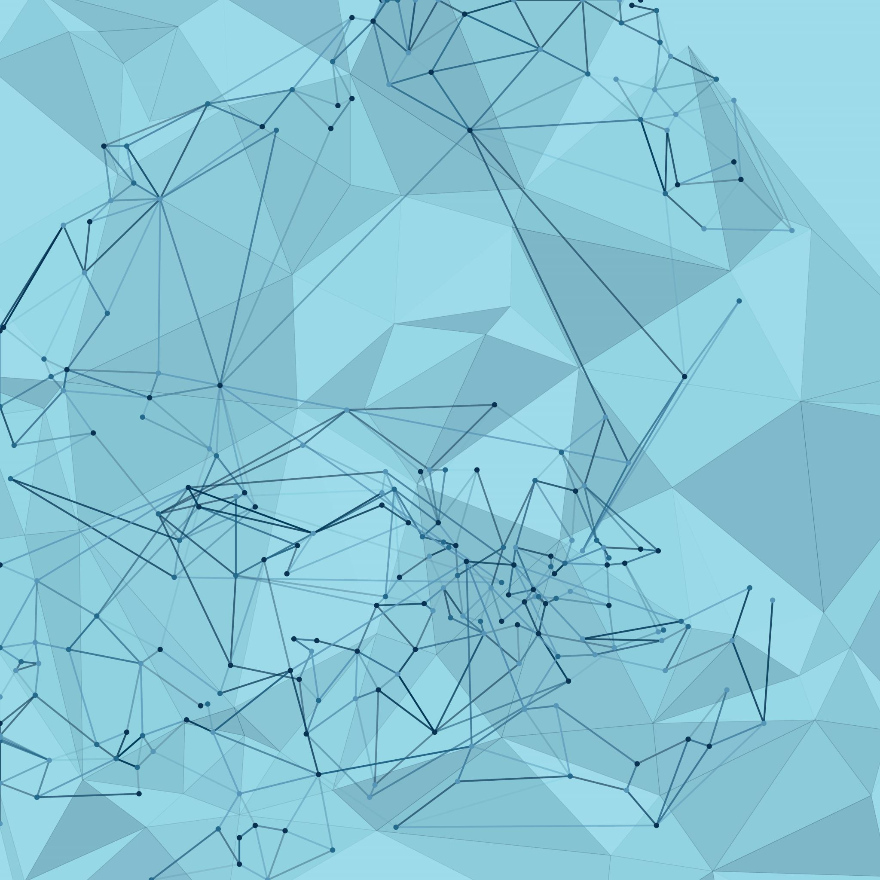
USE OF AI IN HEALTH CARE: TREATMENT AND DIAGNOSIS AND TREATMENT
By Jayant Bangia

Slide 2
WHAT PROBLEM WE FACE WHICH AI CAN SOLVE?
Misdiagnosis or delayed diagnosis might cause patients to suffer negative consequences.
Standard treatment methods may not be applicable to each person
Traditional drug discovery methods are slow and time-consuming
Inefficient of resources in healthcare worldwide issues

Slide 3
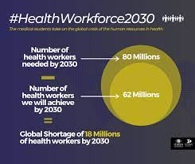
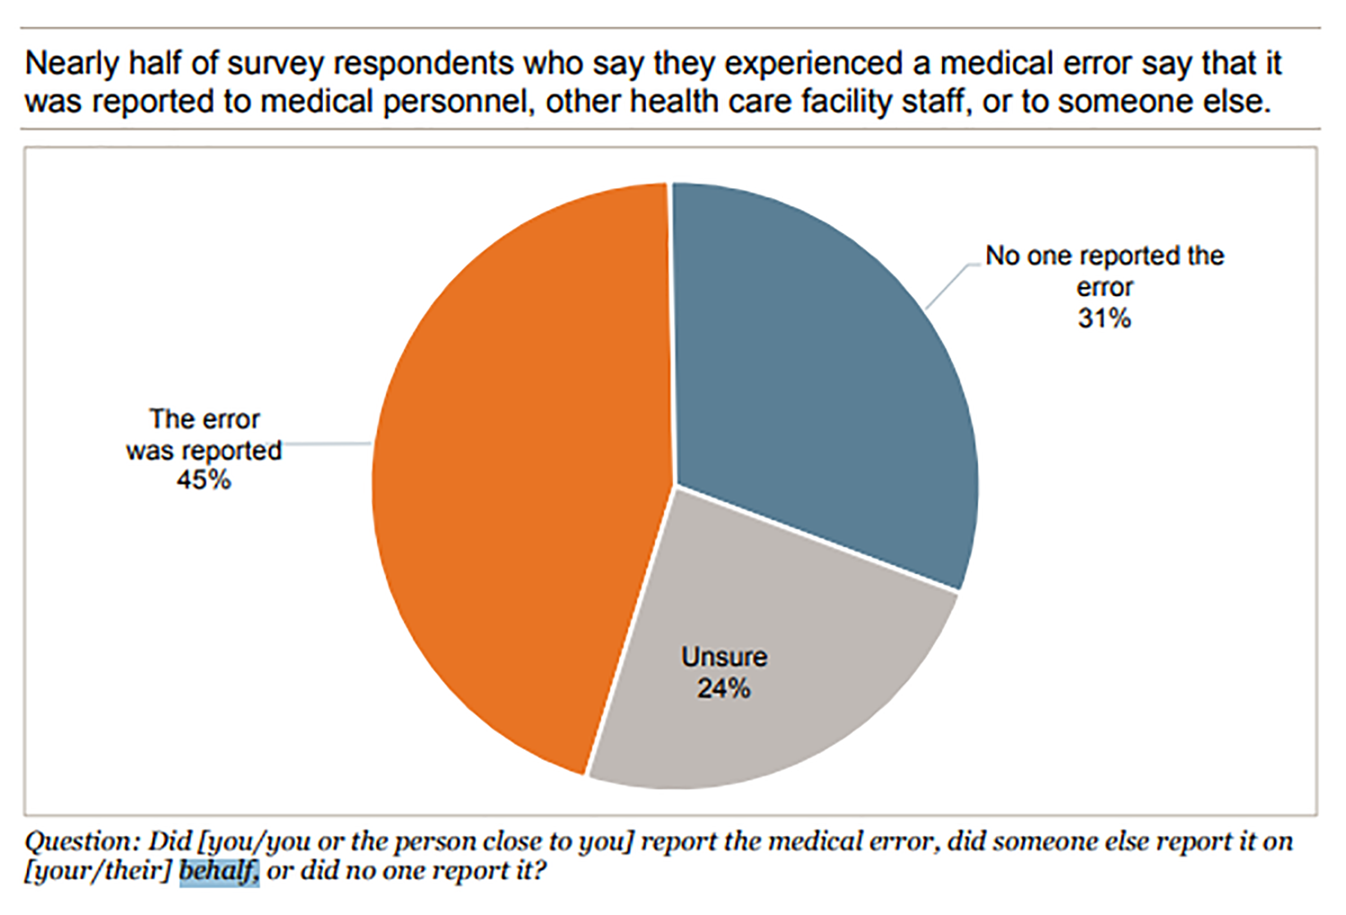
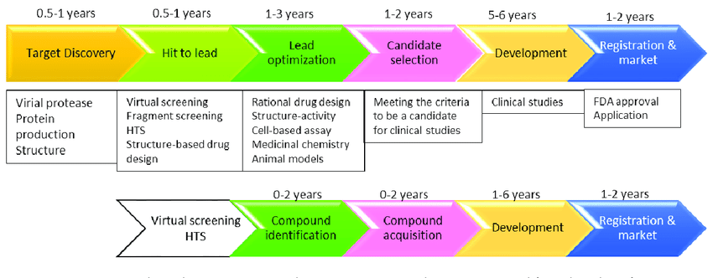
ABOVE PROBLEMS STATISTICS
SHORTAGE
PREDICTION IN HEALTH WORKFORCE
DRUG PREPARATION PROCESS
FAILURE IN DISEASES DETECTION

Slide 4
AI Solution
Solution 1(Dot Image Scanning)
Large volumes of medical data, such as genetic data, imaging scans, and patient records, can be analysed using machine learning algorithms to help medical practitioners diagnose patients more quickly and accurately. Artificial Intelligence can spot patterns and abnormalities that the human eye might miss.
Solution 2(Pattern Recognition)
AI can analyse the patterns of an individual human and then specific the treatment for a person which will be suitable according to their lifestyle as AI can identify anomalies and pattern to enhance the treatment and reduce the side effects

Slide 5
Solution Continues
Solution 3(Lowering time in drug development)
Drug development time can be reduced by machine learning algorithms that can easily identify the patterns that can evaluate the biological data to discover target proteins and simulate drug interactions, dramatically lowering the time and resources necessary for drug development.
Solution 4(Chatbots System)
Virtual assistants and chatbots can streamline administrative tasks and handle daily tasks so that healthcare professionals can focus on more complex tasks and emergency cases

Slide 6
CONCLUSION
HEALTH IS THE MOST IMPORTANT
THING IN THIS WORLD
AND
AI CAN SAVE IT

Slide 7
RESOURCES
https://www.advisory.com/topics/artificial-intelligence/2023/09/ai-strategy?utm_source=google&utm_medium=cpc&utm_campaign=nb&utm_content=aistrategy&gad_source=1&gclid=CjwKCAiAjfyqBhAsEiwA-UdzJAyL1w-kLUbjC-UKowEKxcIQLcNBmlJpSQFDdX_rprLajLwVpn4CAxoCnPkQAvD_BwE&gclsrc=aw.ds
https://www.jnj.com/innovation/artificial-intelligence-in-healthcare?&utm_source=google&utm_medium=cpc&utm_campaign=GO-USA-ENG-PS-Corporate+Equity-GP-EX-RN-NB_STORIES_ARTIFICIAL+INTELLIGENCE&utm_content=AI+-+Healthcare&utm_term=ai+in+healthcare&gclid=CjwKCAiAjfyqBhAsEiwA-UdzJL3ckbtbuDuyTl3QaFa7JSIDQzlN73UONqxU8GqmaTtqxQ-MxJ0lxBoCpt0QAvD_BwE&gclsrc=aw.ds

